Slide 1
FIFA 21
FROM EXPATIATE TO A SIMPLIFIED ANALYSIS
By
Jose, Jeremy, Pedro and Preeya

Slide 2

Objectives
About Fifa 21 and the dataset
Above market value or below market value?
Enhancing our Team
How the position of player impacts his salary?

Slide 3


FIFA 21
Fifa 21 is an association of football simulation
video game published by Electronic Arts (EA) as
part of the FIFA series.
It is the 28th installment in the Fifa Series, and was released on
9 Oct’20 for MS Windows, Nintendo Switch, PS4 & Xbox One
PROCESS:
Data Preparation
Data Preprocessing
Objective/Desired Outcome
EDA
Modelling
Notes:
From the game because old players, players statistics

Slide 4
Above market value or below market value?

Slide 5
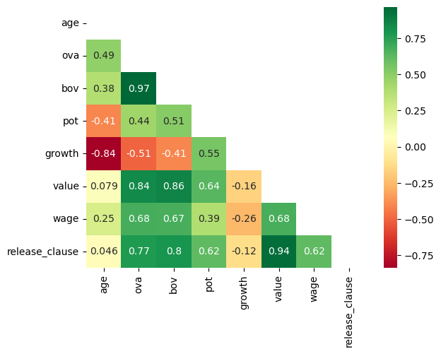
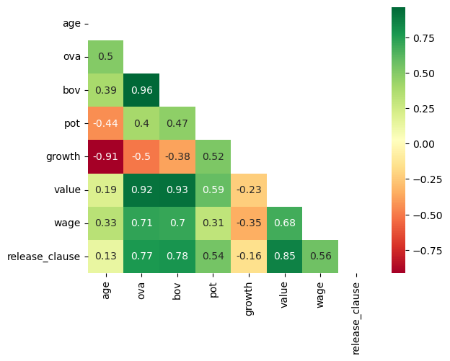
Correlation Factor Using HeatMap
Method: Pearson
Method:Spearman
Notes:
Selected the column that influence market value and not using player statistics. This would make our dataframe easier to handle.
Features: "Name", "Age", "Club", "OVA", "BOV", "BP", "POT", "Growth","Position", "Contract", "Loan Date End", "Wage", "Release Clause"
Target :Value
Created the dataset ordered by Player value.
Values, wage and release clause are object, so we changed them to be numbers.
We have reduced the range of values. Using the full range was not giving us the desired output so we decided to use this range to represent the 'middle class' of players.
fifa_market_value = fifa_market_sorted[(fifa_market_sorted.value < 25000000) & (fifa_market_sorted.value > 750000)]
3. We are using Pearson correlation factor, which are used for linear regression.
4. Correlation factor seems good for reduced range.

Slide 6
Linear Regression on reduced range
fifa_market_value = fifa_market_sorted[(fifa_market_sorted.value < 25000000) & (fifa_market_sorted.value > 750000)].select_dtypes(include='number')
model = linear_model.LinearRegression()
X = fifa_market_value.drop('value', axis = 1)
y = fifa_market_value.value
result = model.fit(X, y)
Result = 0.9386760513287263
Our model, based on the feature and the range selected, is validated

Slide 7
Enhancing our Team
Sevilla

Slide 8
Player to Substitute
Based on contract term and stats

Slide 9
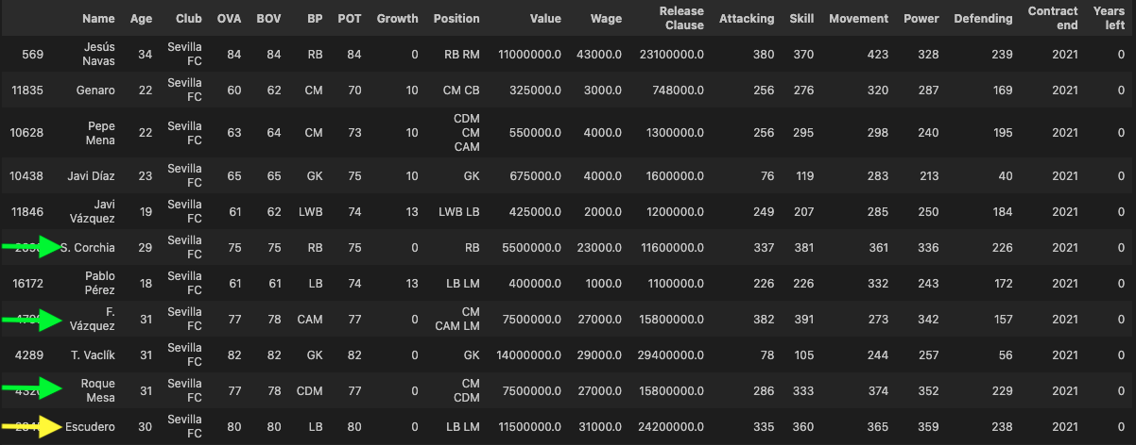
Player to Substitute

Slide 10
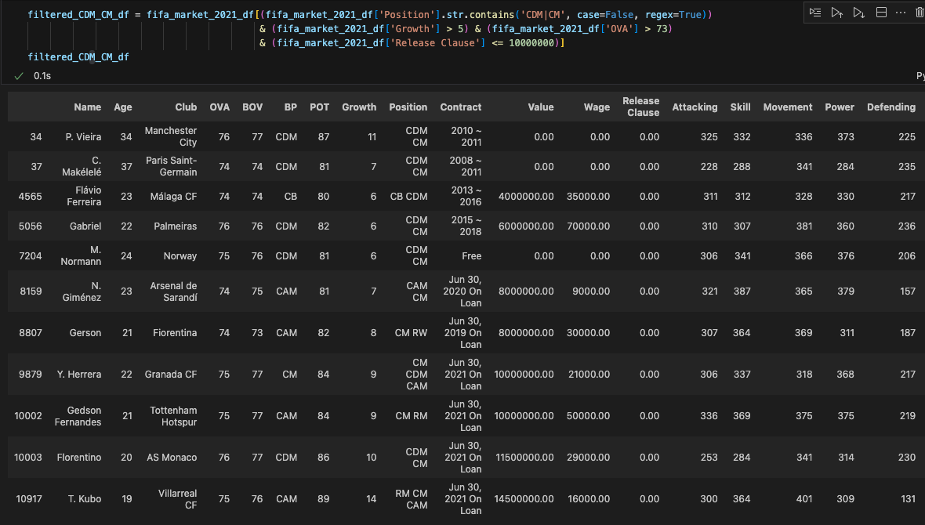

Slide 11
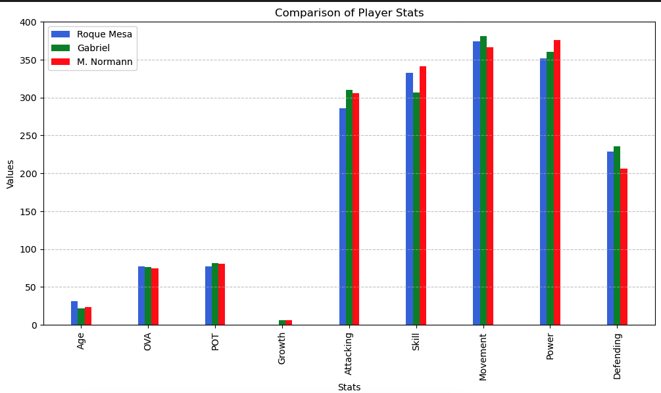

Slide 12
Does a player position impact his wage?

Slide 13
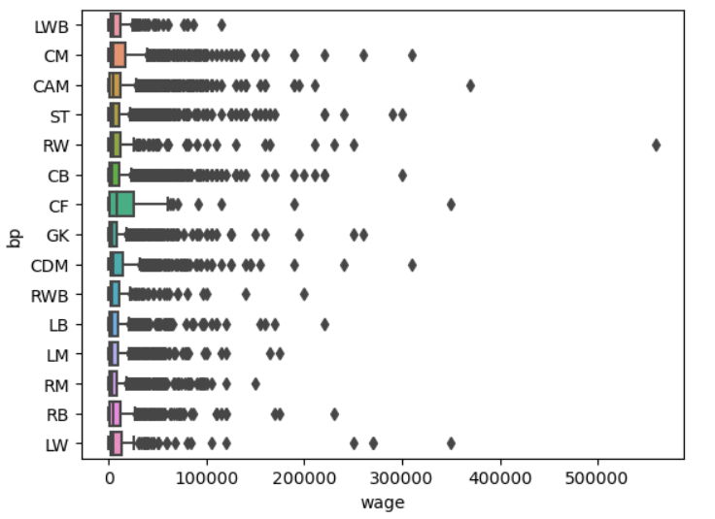
Wage for players can get super high, but only for a few of them
We focus on more normal wages : below 100 000 €

Slide 14
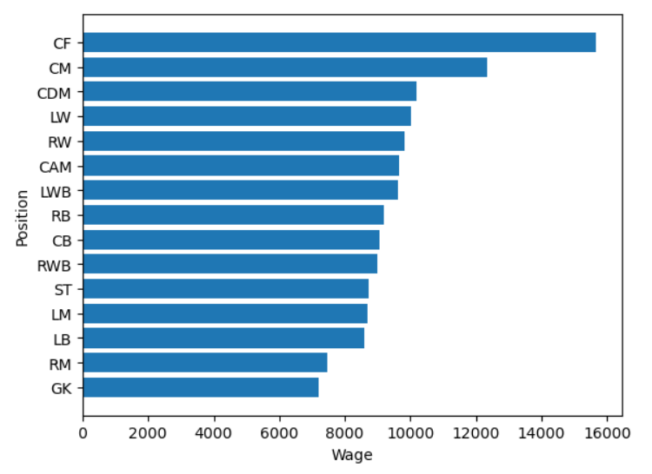
The average wage is higher if you play at the front of the field
The average wage is lower if you play at the back of the field

